Slide 1
Climate
Ever Changing!

Slide 2
Outline
Definitions
Koeppen Climate Classification System
Scales of climate change & their causes
Ice Ages (Glacials & Interglacials)
Evidence of climatic change
Past & Future
The Future?

Slide 3
Definitions
Climate
A statistical description of weather variables averaged over a 30-year time period
Include seasonal & annual variations
The same statistical result could be provided by several different input figures
i.e. one can derive a mean of 10 in many different ways…
Thus we must account for possible variation within this 30 year period.

Slide 4
Definitions
Climate (Cont.)
30 years is not very long in terms of human ‘civilization’ or even the human occupation of earth
Especially not in comparison to the age of earth itself (4.6 billion years)
When considering climate CHANGE, the TIMESCALE in question is PARAMOUNT!!!
Notes:
Anatomically modern humans first appear in the fossil record in Africa about 130,000 years ago, although studies of molecular biology give evidence that the approximate time of divergence from the common ancestor of all modern human populations was 200,000 years ago.

Slide 5
Scales Of Climate Change
Very long term
Hundreds of thousands to millions of years
Long term
Thousands of years
Short term
Hundreds of years
Decadal
Approx. 10 years

Slide 6
Scales Of Climate Change
Each scale of change has different fundamental causes of climatic change
But those causes may overlap and combine to create exaggerated effects. For example:
Very long term – Plate Tectonics
Long term – Milankovitch cycles
Short term – Feedback effects
Decadal – ENSO events, Sun-Spot activity, changes in atmospheric gases…

Slide 7
Koeppen Classification System
Classifies the Earth’s climate
One of many systems; one of the most commonly used.
Developed by Vladimir Koeppen, a German climatologist, around 1900.
Based on the concept that native vegetation is the best expression of climate
Thus climate zone boundaries have been selected with vegetation distribution in mind.
Combines average annual and monthly temperatures and precipitation, and the seasonality of precipitation.

Slide 8
Koeppen Classification System
Divides climates into 5 main groups (a 6th is based on elevation) & several subtypes; each represented by a series of letters
Group A:
Tropical – Temp. in all months is over 18 °C (64 °F)
Group B:
Dry – Potential evaporation exceeds precipitation
Group C:
Mild Mid-Lat – Coldest months between –3 °C (27 °F) & 18 °C (64 °F); summers may be hot
Group D:
Severe Mid-Lat – Coldest months below –3 °C (27 °F) with some snow; mild summers
Group E:
Polar – All months below 10 °C (50 °F)
Group H:
Highland – As above, due to elevation

Slide 9
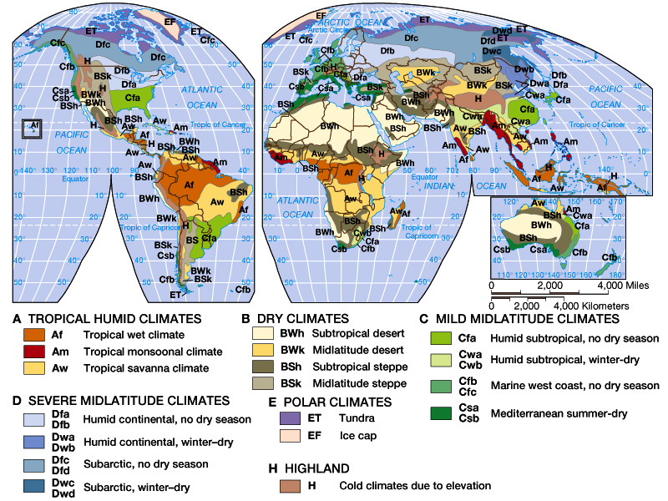
Fig. 15-1, p. 456

Slide 10
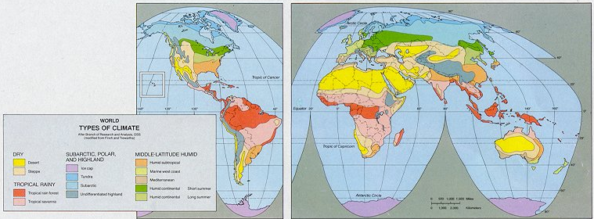
Low-Latitude Climates
Tropical Rain Forest
Rainy, Hot, No Distinct Dry Season
Found Along the Equator (Equatorial Low)

Slide 11
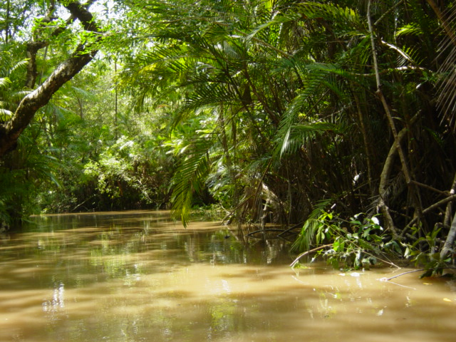
Amazon Rainforest

Slide 12
Low-Latitude Climates
Tropical Savanna
Rainy, Warm, Brief Distinct Dry Season

Slide 13
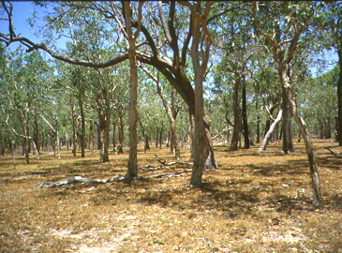
Northern Australia

Slide 14
High-Latitude Climates
Subarctic
Cold Climate with Abundant Precipitation
Tundra
Colder and Drier With Dwarfed Vegetation; Permafrost

Slide 15
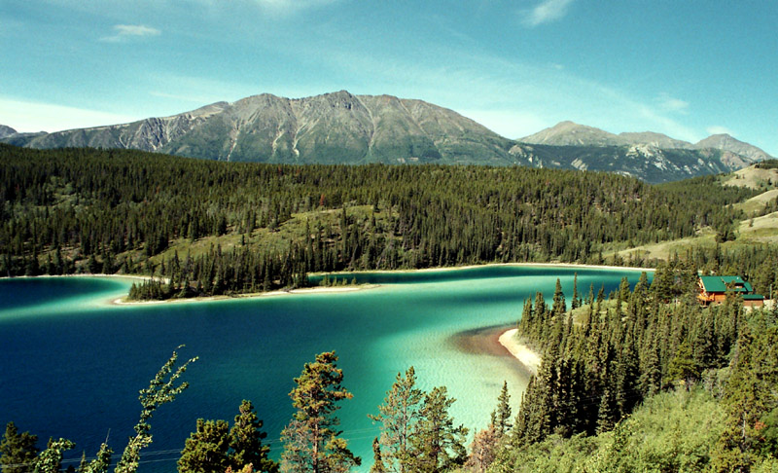
Yukon, Canada – Subarctic

Slide 16
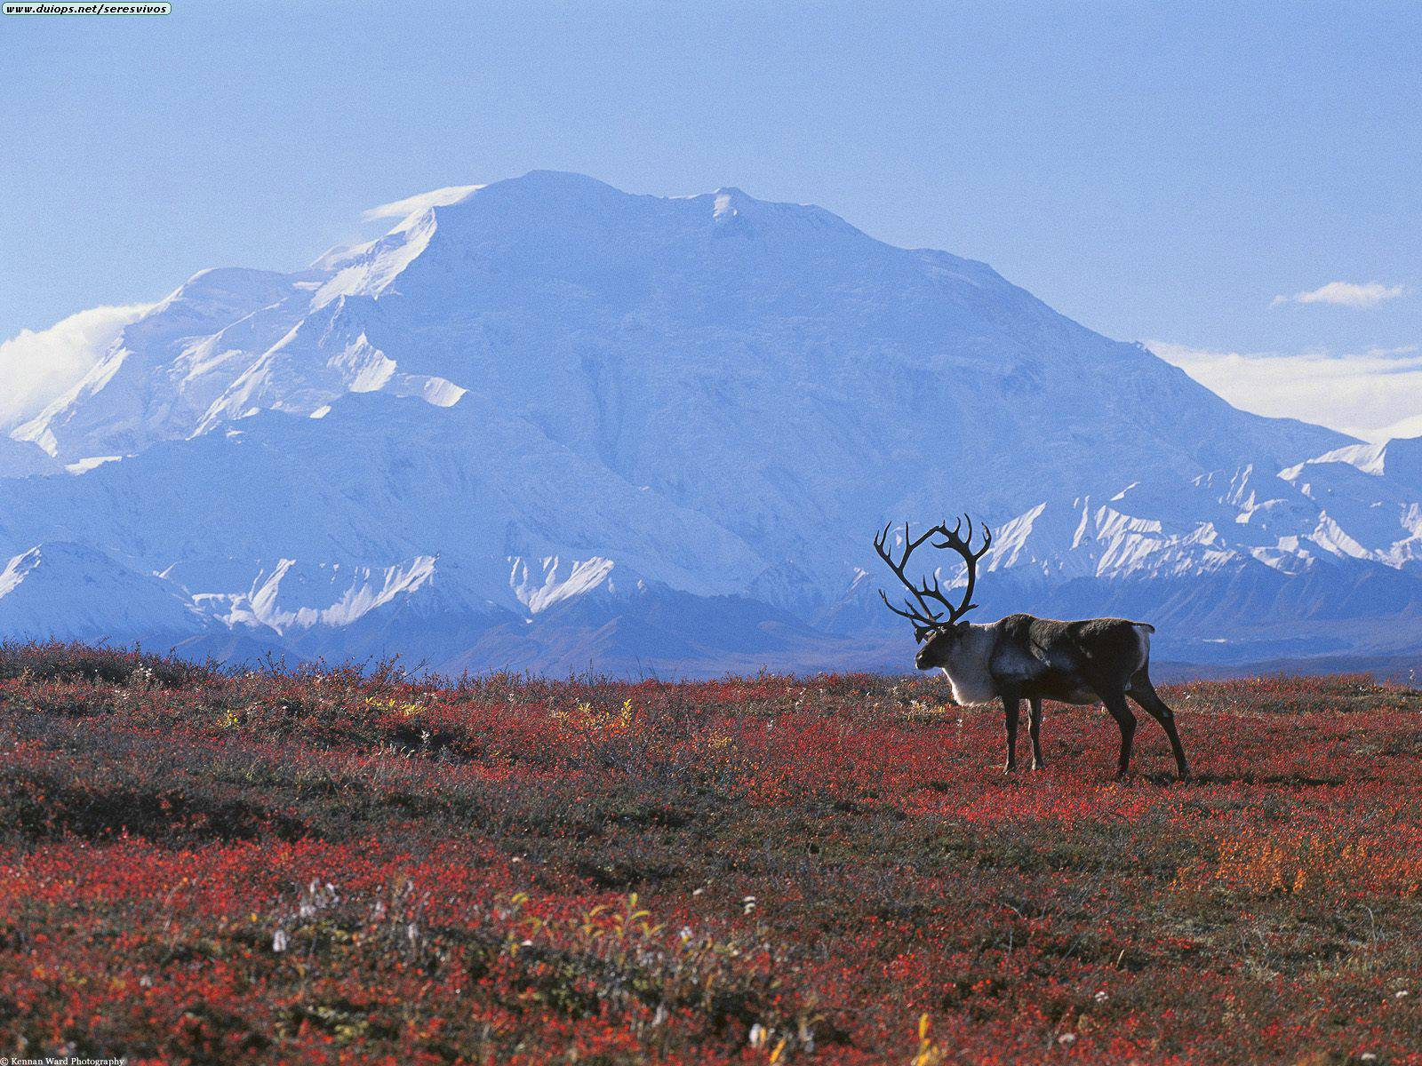
Alaska – Tundra

Slide 17
High-Latitude Climates
Ice Cap
Cold Desert. Annual precipitation is usually less than 10 inches (definition of Desert).

Slide 18
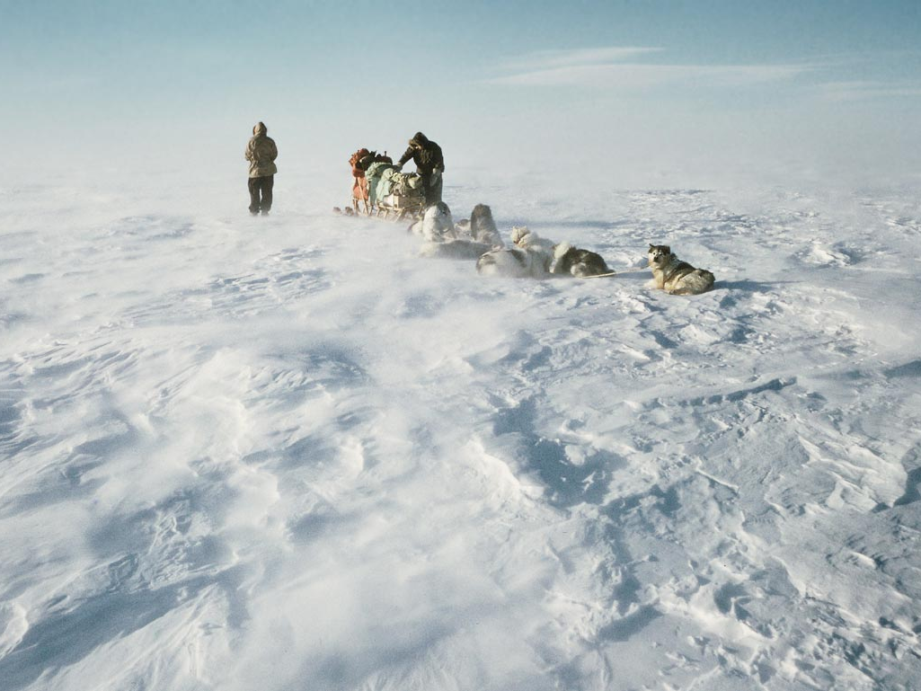
Antarctica – Ice Cap

Slide 19
Climates Unrelated to Latitude
Undifferentiated Highland
Climate Zone for Highland Areas. Based upon elevation rather than latitude. Unsaturated air will cool at a rate of 10°C per 1000m rise

Slide 20
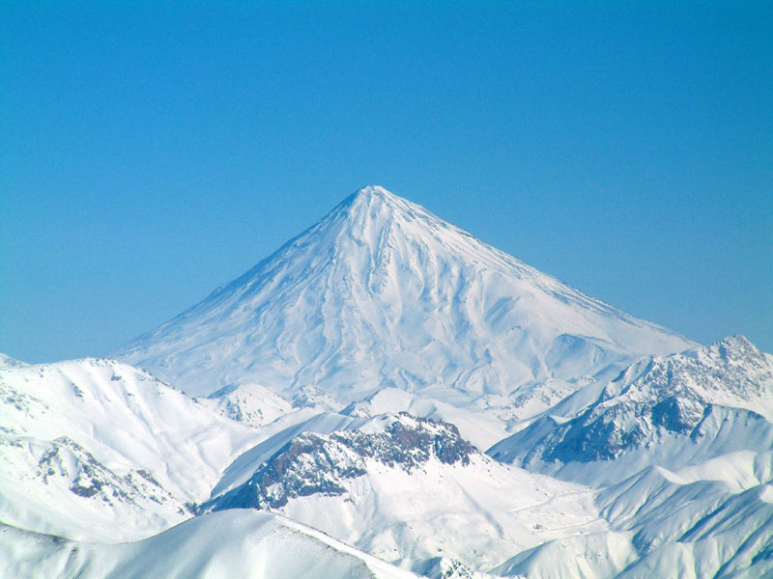
Iran – Highland

Slide 21
Ice Ages (Glacials & Interglacials)
Ice Ages
A period of long-term downturn in the temperature of Earth's climate
Resulting in an expansion of the continental ice sheets, polar ice sheets and mountain glaciers
We are currently within an Ice Age!
The Earth’s climate is typically warmer than it is now!
The Arctic Sea is not ‘usually’ frozen year round
Warm periods last for hundreds of millions to billions of years
Punctuated by Ice Ages (lasting 10-100 MY)

Slide 22
Ice Ages (Glacials & Interglacials)
Ice Ages (Cont.)
The climate within an Ice Age is NOT UNIFORM.
The climate will undergo periods of cooling, where Ice caps and Glaciers grow, and
Warming, where Ice caps and Glaciers recede
These are known as Glacials & Interglacials
Thus, even though we are in the middle of an Ice Age (e.g. the Arctic Sea is mostly frozen year round), we’re presently experiencing an ‘Interglacial’

Slide 23
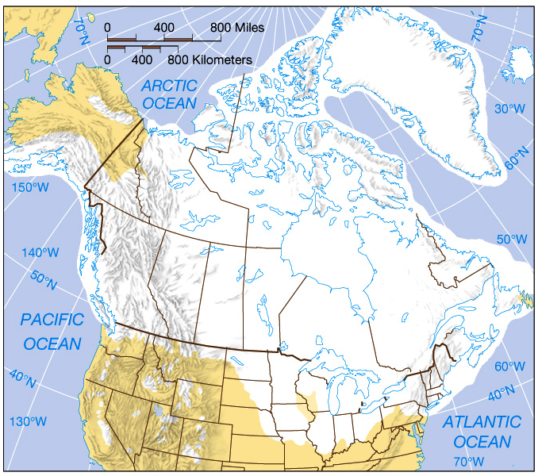
The Last Glacial Maximum is the most studied glaciation, because it was so recent (18-20,000 years ago) and was so extensive

Slide 24
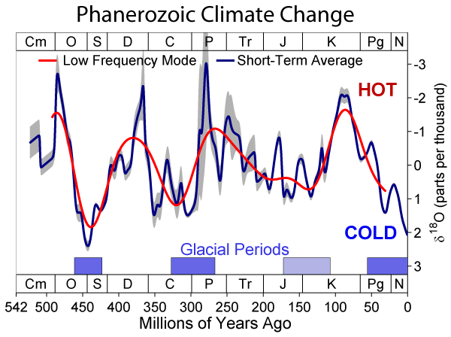
Ice Ages (Glacials & Interglacials)

Slide 25
Evidence of Climate Change
Cores through existing ice
Vegetation changes in the past
Landform changes in the past
Historical records

Slide 26
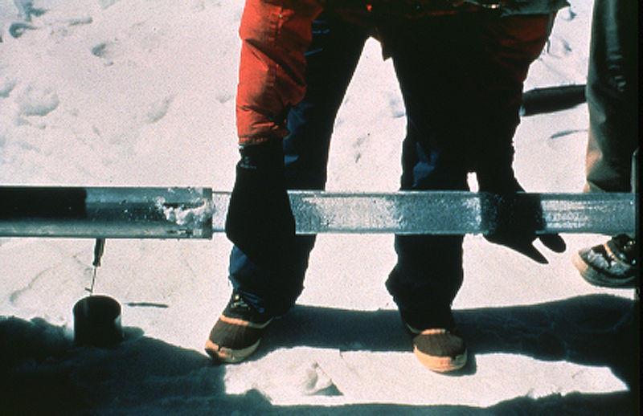
Cores Through Existing Ice
Ice cores are taken in Greenland, Antarctica and in smaller (high altitude) glaciers.
They show changes in the gaseous composition in the atmosphere, which can explain warming or cooling trends

Slide 27
Vegetation Changes In The Past
Dead tree stumps in unusual areas
Pollen grains in sediments revealing wildly different vegetation patterns
Ancient trees adapting to seasonal changes
Visible through variations in their ring width

Slide 28
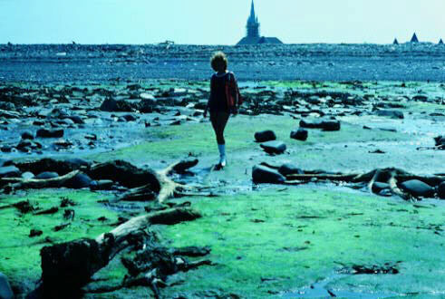
Dead tree stumps found below high tide indicate that sea level was once lower…
Cape Sable, Nova Scotia, Canada

Slide 29
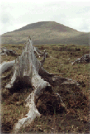
In County Mayo, Ireland, trees once grew where only bogs or wetlands now survive, indicating that climate was once warmer…

Slide 30
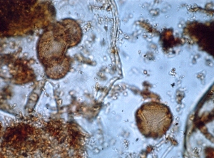
Pollen grains look significantly different depending on their family, genus and species. They can be recognized easily. They are very tough and last a really long time…

Slide 31
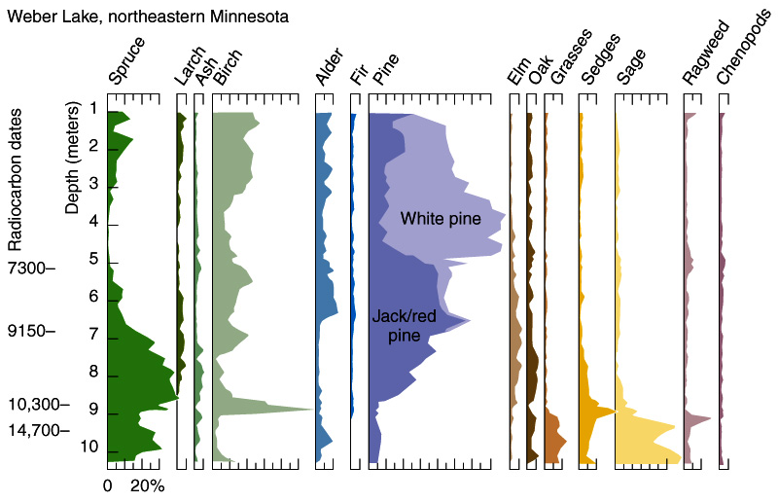
As Spruce died out, so Pines took over. They have different moisture and temperature requirements, so do not co-exist.

Slide 32
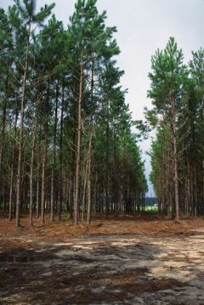
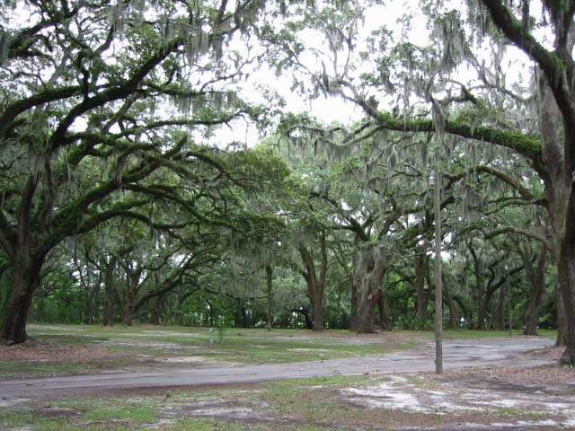
Vegetation Changes In The Past
In Florida, pollen records show that areas that are now dominated by Slash Pine (which prefers humid climates and moist soil)
Were once drier, and were dominated by Live Oak.
The climate became the way it is now approx. 5,000 years ago.

Slide 33
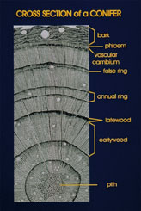
Dendrochronology is the study of tree rings.
Trees grow in concentric circles, with a wider ring in spring/summer and a narrow, dark ring in winter.
Adequate moisture and a long growing season result in a wide ring.
A drought year may result in a very narrow one.

Slide 34
Landform Changes In Past
Using Florida as an example, we can see how sea level was once MUCH higher!
Leaving only the thin central peninsula as a string of islands
Other ridges and bays can be seen
The Keys are coral reefs formed below sea level, but now exposed up to 18m above…

Slide 35
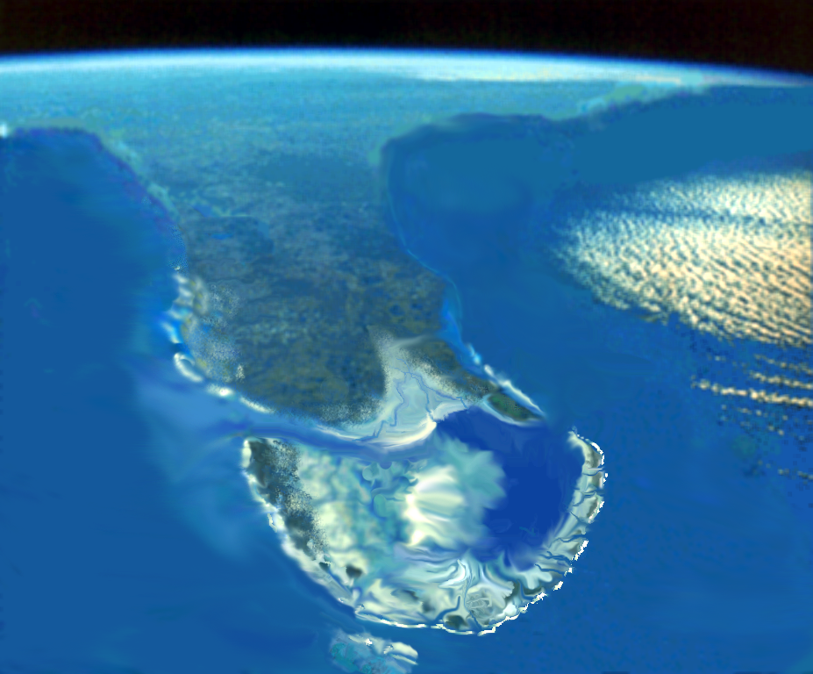
Tamiami Subsea
With Everglades Pseudoatoll
Myakka
Lagoon
System
St. Lucie Peninsula
Polk Peninsula
Loxahatchee Strait
Kissimmee
Embayment
Caloosahatchee Strait
Palm Beach
Reef Tract
Immokalee
Archipelago
and Reef
Tract
Hendry Platform
Loxahatchee
Trough
Miami
Reef
Tract
Cape Sable
Bank

Slide 36
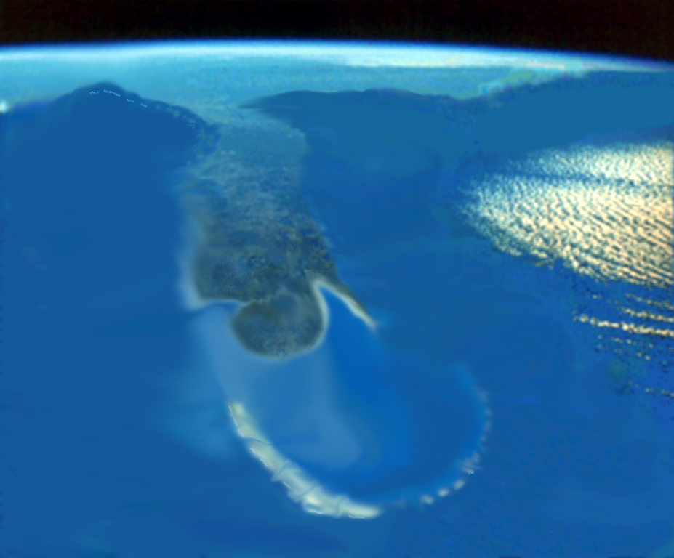
Arcadia Subsea
Parachucla
Embayment
Torreya
Lagoon
System
Loxahatchee
Trough
Collier
Banks
Dade
Banks

Slide 37
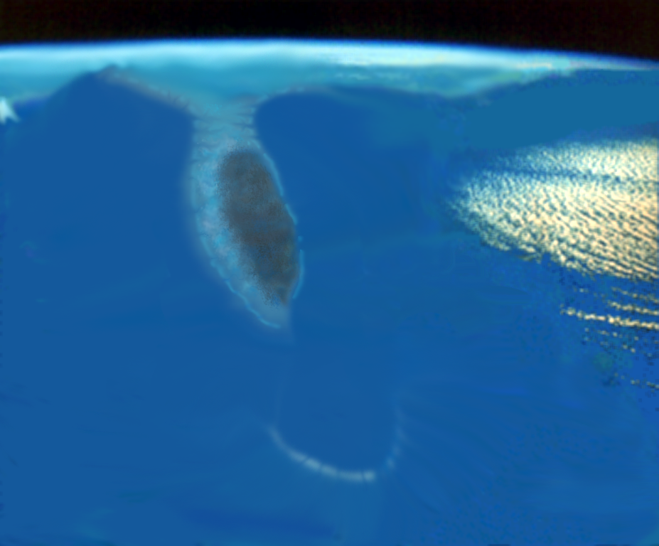
Dade Subsea
Suwannee Strait
Orange
Island
Pasco
Reef
System
Yeehaw Strait
Dade
Banks
Collier
Banks

Slide 38
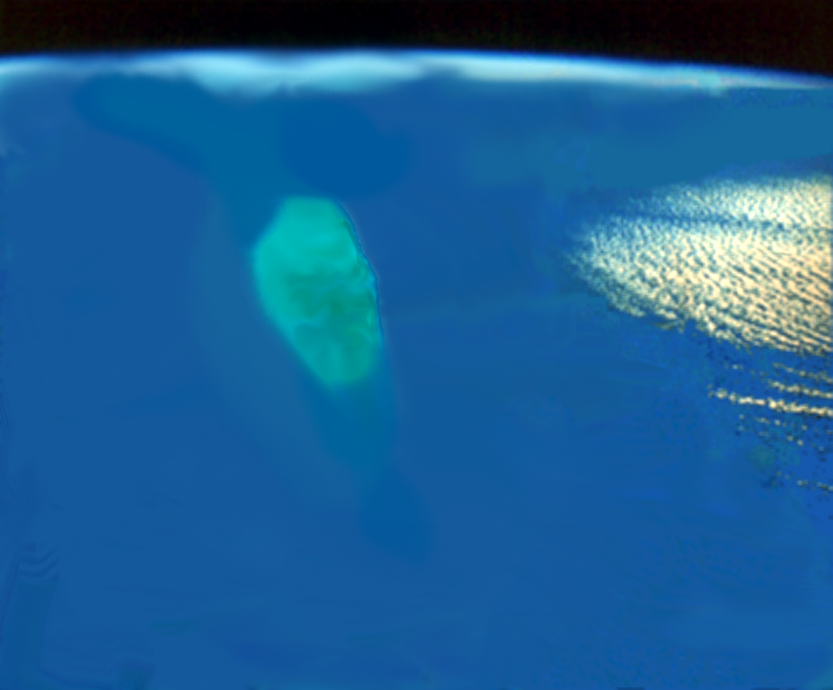
Ocala Sea
Suwannee Strait
Inglis
Reef
Tract
Ocala
Bank
South Floridian Shelf

Slide 39
Landform Changes In Past
We also have evidence of LOWER sea level, in the form of:
river valleys
drowned forests and
freshwater sediments.
At its lowest level, the sea left Florida as a broad continent

Slide 40
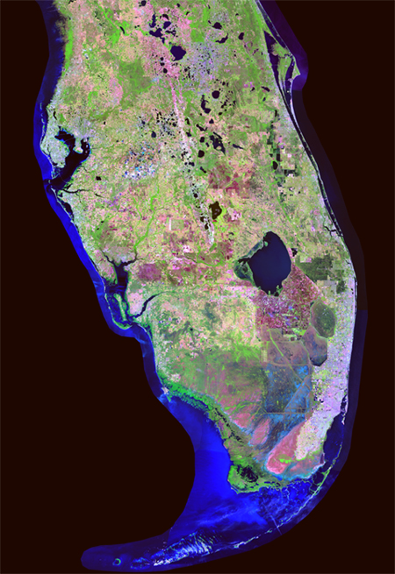
Lake Wales Ridge
Drowned valleys

Slide 41
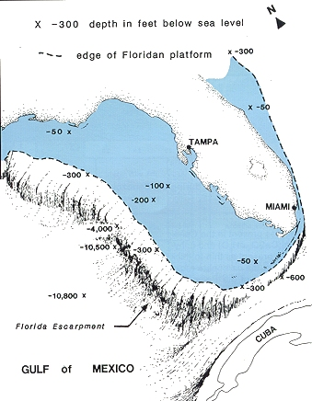
Florida when sea level was lower…

Slide 42
Historical Records
People have long kept records of weather: especially farmers.
By looking at crops grown, we can estimate past weather conditions
e.g. Romans grew grapes for wine in UK & Germany 2000 years ago
This could not be done today

Slide 43
Historical Records
Vikings traveled to Iceland, Greenland and North America (Newfoundland)
They established colonies in each place.
This was during the Medieval Optimum, a warm period between 800-1300 AD, when we also find evidence of retreating (shrinking) glaciers

Slide 44
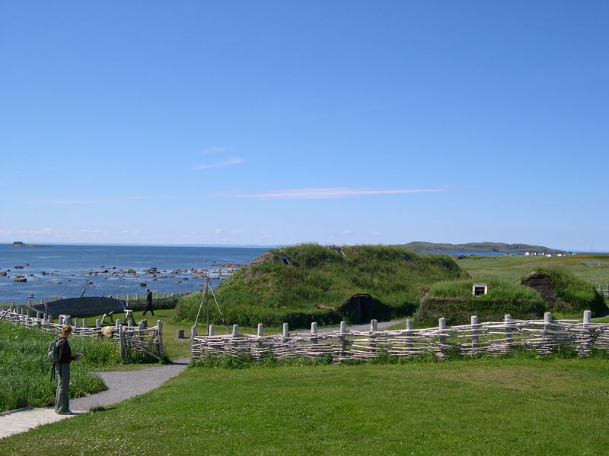
L'Anse aux Meadows, Newfoundland, Canada – oldest Viking site in North America

Slide 45
Historical Records
Eventually, the Viking colonies died out
Stories explain that this was due to increased sea ice cover and very cold weather…
This may have been the beginning of the Little Ice Age (1400-1850 AD)
Glaciers advanced, major European rivers froze over, high elevation farmland had to be abandoned

Slide 46
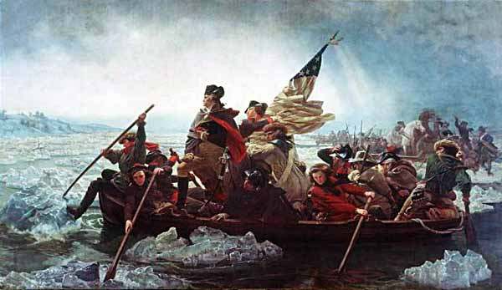
Washington Crosses the Delaware (December 25, 1776)… …IN THE MIDDLE OF THE ‘LITTLE ICE AGE’!

Slide 47
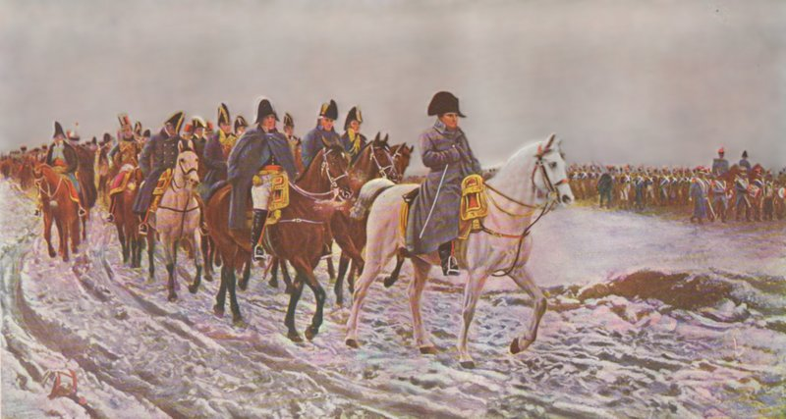
Napoleon's ‘Little Ice Age’ Invasion of Russia (1812) Did Not Go So Well…

Slide 48
Ice Ages (Glacials & Interglacials)
Ice Ages (Cont.)
The ‘peak’ of our present Ice Age occurred at the beginning of our present Geologic Time Period, the Quaternary
Approximately 2 Million Years Ago (MYA)
This period is further subdivided into two ‘Epochs’ known as the:
Pleistocene – 2 MYA to 10,000 YA
Holocene – 10,000 YA to The Present
The Holocene is an interglacial. On average, Interglacials last about 10,000 years. This one is approx. 10,000 years old…

Slide 49
The Future?
According to the climate pattern of the Quaternary, the Earth is due for another period of Glaciation. However…
Intergovernmental Panel on Climate Change (IPCC)
Internationally recognized authority on climate change
Has declared that the evidence of Global Warming is UNEQUIVOCAL!!!
It is is very likely (confidence level >90%) that the majority of this warming is due to the observed increase in anthropogenic (human) greenhouse gas concentrations.

Slide 50
Sir David Attenborough…

Slide 51
Anthropogenic Warming
Little Ice Age
Medieval Warm Period

Slide 54
Feedbacks
Feedbacks- Responses to change in temperature that accentuate or oppose change
Positive Feedbacks
Melting of ice reduces albedo raises Temp
More evaporation increases water vapor absorbs LW raises T
Negative Feedbacks
More Temp means more convection means more clouds increasing albedo

Slide 55
Ice Ages (Glacials & Interglacials)
Conditions of the last Warm Interval…
Global Average Temp. 5 to 15 C (9 to 27 F) higher than present
Sea Level 150 to 200m (490 to 650ft) higher than present
These conditions are FAR MORE EXTREME than what is presently predicted for our current rate of Global Warming!
The point is that our planet is more than capable of achieving higher temperatures…

Slide 56
The Future?
This compares to projections for the next 100 years of
Between 2 and 6 C (3 and 11 F)
0.1 and 0.9 m (0.3 and 3 ft)
Assuming that neither Greenland nor the West Antarctic Ice Shelf melt
Upon the occurrence of EITHER event sea levels would rise 20ft!
IF the warming that we are presently experiencing continues unabated

